Slide 1


CS-2001 Data Structures Fall 2022 Binary Heap
Mr. Muhammad Usman Joyia
National University of Computer and Emerging Sciences,
Faisalabad, Pakistan.

Slide 2
Max Heap and Heap-sort

Slide 3
Review to Min-Heap

Slide 4
Algorithm for Building a MIN Heap from Scratch
BUILD_Min_HEAP(A)
1 heap_size[A] ← length[A]
2 for i ← heap_size[A] / 2 downto 1
do MIN_HEAPIFY(A, i )
MIN_HEAPIFY(A, i )
1 l ← 2i
2 r ← 2i + 1
3 if l ≤ heap_size[A] and A[ l ] < A[i ]
4 then min ←l
5 else min ←I
6 if r ≤ heap_size[A] and A[r] < A[min]
7 then min ←r
8 if min != i
9 then exchange A[i ] ↔ A[min]
10 MIN_HEAPIFY(A, min)

Slide 5
Algorithm for Building a MIN Heap from Scratch
ExtractMin(A)
1 MinVal ← A[1]
2 A[1] ← A[heap_size[A] ]
3 Heap_size[A] ← Heap_size[A] -1
4 MIN-HEAPIFY(A, 1)

Slide 6
Algorithm for Building a MIN Heap from Scratch
Insert(A, val )
1 heap_size[A] ← heap_size[A] + 1
2 A[heap_size[A]] ← val
3 PercolateUp_Min(A,heap_size[A])
PercolateUp_Min(A,i)
1 While( parent( i ) >= 1) do
if A[i] < A[ parent( i )] then
exchange A[i ] ↔ A[parent( i )]
i ← parent( i )
continue to next iteration
END if
Break
END While

Slide 7
MAX HEAP

Slide 8
Algorithm for Building a Max Heap from Scratch
BUILD_MAX_HEAP(A)
1 heap_size[A] ← length[A]
2 for i ← heap_size[A] / 2 downto 1
do MAX_HEAPIFY(A, i )
MAX_HEAPIFY(A, i )
1 l ← 2i
2 r ← 2i + 1
3 if l ≤ heap_size[A] and A[ l ] > A[i ]
4 then max ←l
5 else max ←I
6 if r ≤ heap_size[A] and A[r] > A[max]
7 then max ←r
8 if max != i
9 then exchange A[i ] ↔ A[max]
10 MAX_HEAPIFY(A, max)

Slide 9
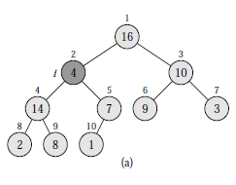
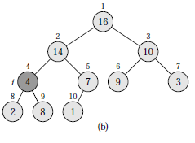
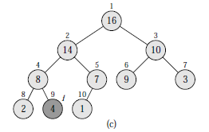
HEAP Data Structure
MAX-HEAPIFY(A, i )
1 l ← LEFT(i )
2 r ← RIGHT(i )
3 if l ≤ heap-size[A] and A[l] > A[i ]
4 then largest ←l
5 else largest ←i
6 if r ≤ heap-size[A] and A[r] > A[largest]
7 then largest ←r
8 if largest != i
9 then exchange A[i ] ↔ A[largest]
10 MAX-HEAPIFY(A, largest)

Slide 10

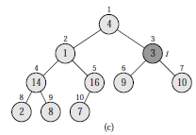
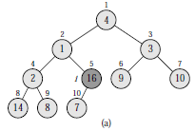
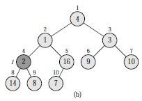
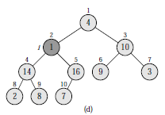
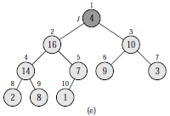
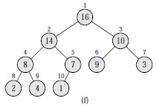
HEAP Data Structure
BUILD-MAX-HEAP(A)
1 heap-size[A] ← length[A]
2 for i ← length[A]/2 downto 1
3 do MAX-HEAPIFY(A, i )

Slide 11
Algorithm for Building a Max Heap from Scratch
ExtractMax(A)
1 MaxVal ← A[1]
2 A[1] ← A[heap_size[A] ]
3 Heap_size[A] ← Heap_size[A] -1
4 MAX-HEAPIFY(A, 1)

Slide 12
Algorithm for Building a Max Heap from Scratch
Insert(A, val )
1 heap_size[A] ← heap_size[A] + 1
2 A[heap_size[A]] ← val
3 PercolateUp_MAX(A,heap_size[A])
PercolateUp_MAX(A,i)
1 While( parent( i ) >= 1) do
if A[i] > A[ parent( i )] then
exchange A[i ] ↔ A[parent( i )]
i ← parent( i )
continue to next iteration
END if
Break
END While

Slide 13

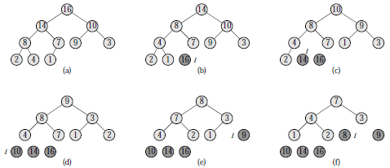
HEAP Data Structure
HEAPSORT(A)
1 BUILD-MAX-HEAP(A)
2 for i ← length[A] downto 2
3 do exchange A[1] ↔ A[i ]
4 heap-size[A] ← heap-size[A] − 1
5 MAX-HEAPIFY(A, 1)

Slide 14
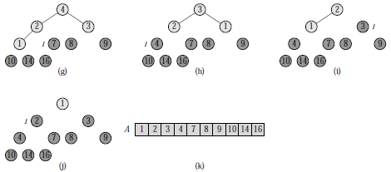
HEAP Data Structure
HEAPSORT(A)
1 BUILD-MAX-HEAP(A)
2 for i ← length[A] downto 2
3 do exchange A[1] ↔ A[i ]
4 heap-size[A] ← heap-size[A] − 1
5 MAX-HEAPIFY(A, 1)

Slide 15
Any Question So Far?

